Slide 1
ECE 471/571 – Lecture 7
Dimensionality Reduction – Fisher’s Linear Discriminant
09/12/14

Slide 2
Different Approaches - More Detail
Pattern Classification
Statistical Approach
Syntactic Approach
Supervised
Unsupervised
Basic concepts:
Baysian decision rule
(MPP, LR, Discri.)
Basic concepts:
Distance
Agglomerative method
Parametric learning (ML, BL)
k-means
Non-Parametric learning (kNN)
Winner-take-all
NN (Perceptron, BP)
Kohonen maps
Dimensionality Reduction
Fisher’s linear discriminant
K-L transform (PCA)
Performance Evaluation
ROC curve
TP, TN, FN, FP
Stochastic Methods
local optimization (GD)
global optimization (SA, GA)
ECE471/571, Hairong Qi

Slide 3
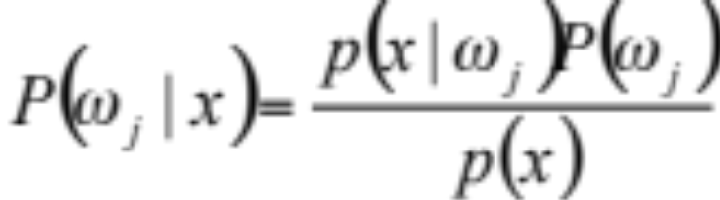
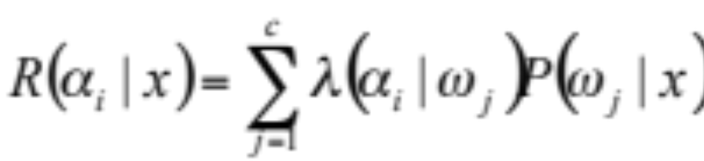

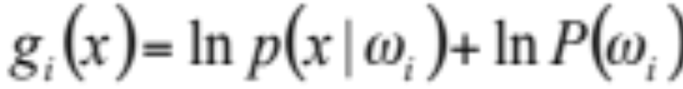
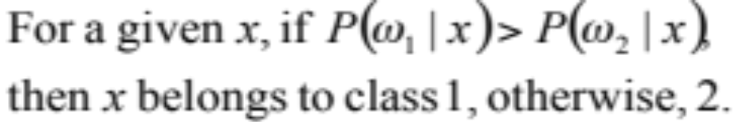
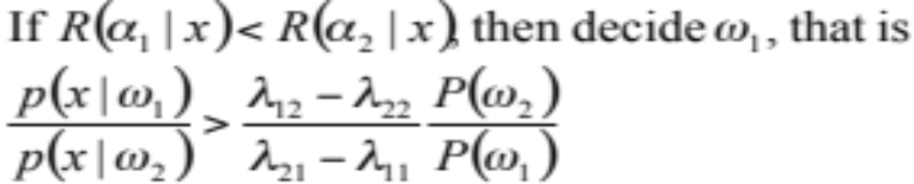
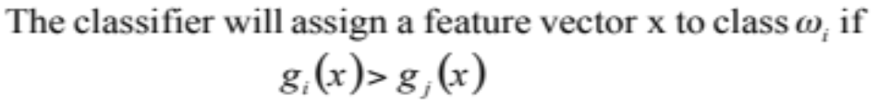
Review
Maximum
Posterior
Probability
Maximum
Likelihood
Discriminant
Function

Slide 4
The Curse of Dimensionality – 1st Aspect
The number of training samples
What would the probability density function look like if the dimensionality is very high?
  For a 7-dimensional space, where each variable could have 20 possible values, then the 7-d histogram contains 20⁷ cells. To distribute a training set of some reasonable size (1000) among this many cells is to leave virtually all the cells empty

Slide 5
Curse of Dimensionality – 2nd Aspect
Accuracy and overfitting
In theory, the higher the dimensionality, the less the error, the better the performance. However, in realistic pattern recognition problems, the opposite is often true. Why?
  The assumption that pdf behaves like Gaussian is only approximately true
  When increasing the dimensionality, we may be overfitting the training set.
  Problem: excellent performance on the training set, poor performance on new data points which are in fact very close to the data within the training set

Slide 6
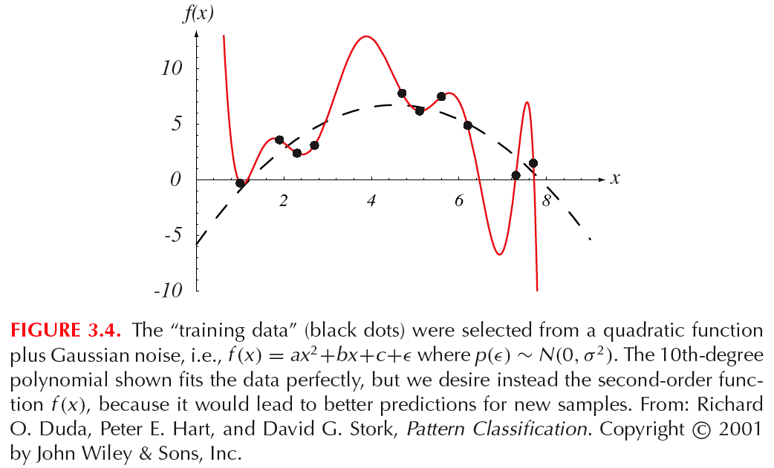
Curse of Dimensionality - 3rd Aspect
Computational complexity

Slide 7
Dimensionality Reduction
Fisher’s linear discriminant
  Best discriminating the data
Principal component analysis (PCA)
  Best representing the data

Slide 8


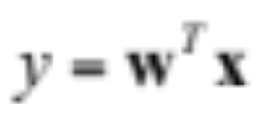

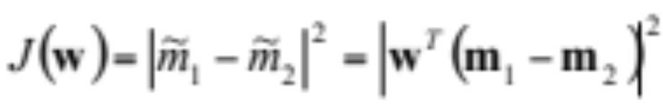
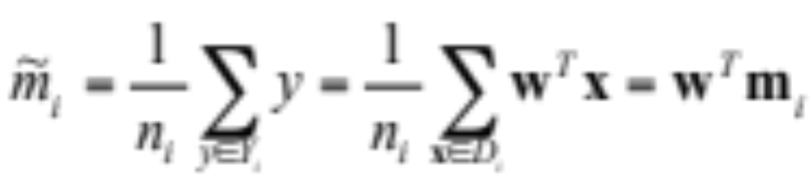
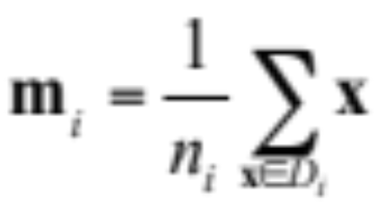
Fisher’s Linear Discriminant
For two-class cases, projection of data from d-dimension onto a line
Principle: We’d like to find vector w (direction of the line) such that the projected data set can be best separated
Projected mean Sample mean

Slide 9
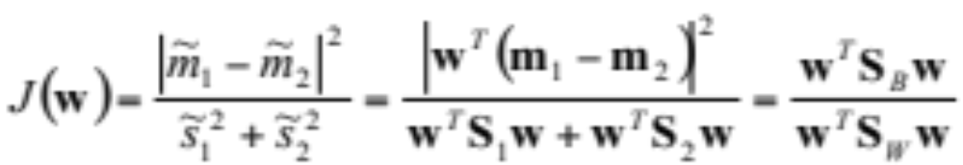
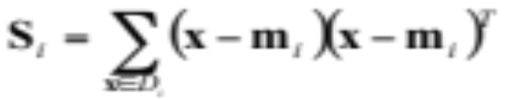

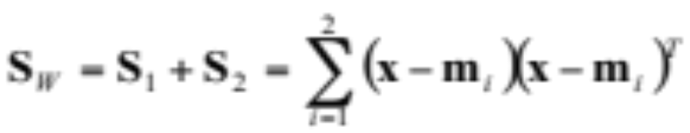
Other Approaches?
Solution 1: make the projected mean as apart as possible
Solution 2?
Scatter matrix
Between-class scatter matrix
Within-class scatter matrix

Slide 10
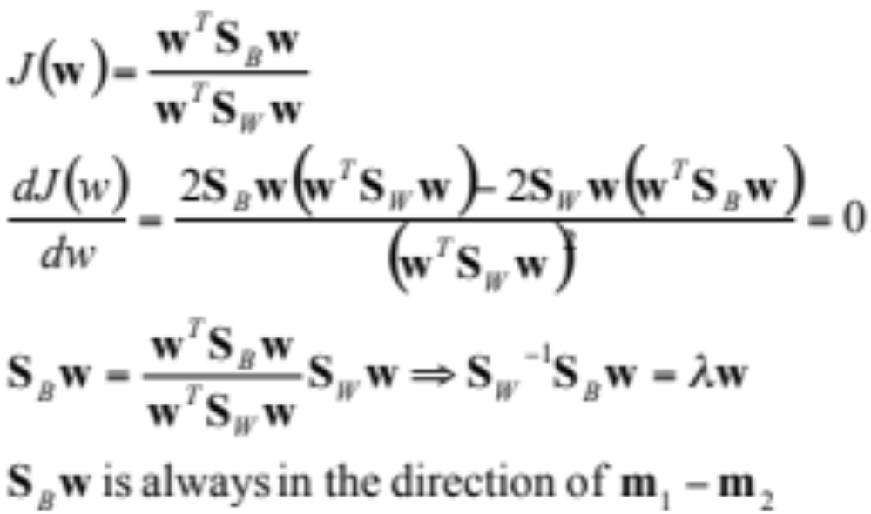
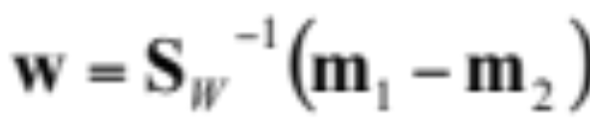
*The Generalized Rayleigh Quotient
Canonical variate

Slide 11
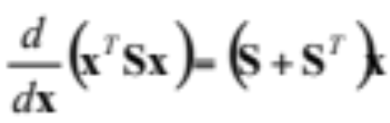

Some Math Preliminaries
Positive definite
  A matrix S is positive definite if y=x^{T}Sx>0 for all R^{d} except 0
  x^{T}Sx is called the quadratic form
  The derivative of a quadratic form is particularly useful
Eigenvalue and eigenvector
  x is called the eigenvector of A iff x is not zero, and Ax=λx
  λ is the eigenvalue of x

Slide 12
** Multiple Discriminant Analysis
For c-class problem, the projection is from d-dimensional space to a (c-1)-dimensional space (assume d >= c)
Sec. 3.8.3

